Slide 1
Final Project
Optimize NCCU Courses Search System.
組員：
企管三 胡冠辰
統計二 詹佳恩
資管一 侯宗成
資管一 陳昱綸

Slide 2
01
Situation
02
Source Code
Agenda
03
Sample Output
04
Conclusion

Slide 3
Situation
While the existing course inquiry system at National Chengchi University provides features such as subject name search and tracking, students still need to go through the process of confirming required courses and searching for general education and physical education courses, making the operation cumbersome and inconvenient.
Therefore, we have decided to optimize the system. Firstly, the system will recognize the user's department and provide three main course selection options: required courses, general education, and physical education. When the user chooses to view required courses, the system will list all required courses that match the user's department. General education and physical education will also display corresponding course lists.
In the end, users can add the courses of interest to their tracking list through this customized system. The system not only presents the user's tracking list but also assists in calculating the required credits for graduation, helping students plan and arrange course selections more conveniently.

Slide 4
Situation
Goal:
Enable students to easily
1.confirm their current earned credits
2.view required course,general course and physical courses
upon entering the course selection system.

Slide 5
Class NCCUStudent
stdID, grade, department, sportCredit, coreSelected, totalGeneralCredit: int
generalCredit: int[]
generalSelected: ArrayList<Course>
sportSelected: ArrayList<Course>
getStdId(), getGrade(): int
addGeneralCourse(Course c):void
addSportCourse(Course c) :void
selectedList(int misSelectedCredit, boolean[] misCheck, MISCourses misCourses) :void
selectedList(int misGraduateSelectedCredit, boolean[] misGraduateCheck, GraduateMISCourses graduatemisCourses):void
Class GraduateStudent
Class MISStudent
CreditFee = 1655: int
totalCreditFee:int
misGraduateSelectedCredit:int
misGraduateCheck:boolean[]
misGraduateSelected:ArrayList<Course>
departmentName:String
misSelectedCredit:int
misCheck:boolean[]
misSelected:ArrayList<Course>
departmentName:String
addMisCourse(Course c):void
selectedList(MISCourses misCourses):void
addMisCredit(Course c):void
Class
diagram
getCreditFee():int
calculateCreditFee():void
getTotalCreditFee():int
addGraduateCourse(Course c):void
selectedList(GraduateMISCourses graduatemisCourses):void
addGraduateMisCredit(Course c):void

Slide 6
Class Course
Course
Modifier and type | Method (or Variable) and description
Instance variable
int | credit The course credit of this course.
int | id The course number of this course.
String | teacher The teacher’s name.
String | name The course name of this course.
String | time The time of this course.
boolean | empty Indicating whether the course is empty, used for error handling or special situations.
boolean | selected Indicating whether the course has been selected.
boolean | core Indicating whether the course is a core course.

Slide 7
Class Course
Constructor
Course(String name, int credit, int id, String time, String teacher, boolean core) Enable to construct a course object with given course name, credit, id, time, teacher, boolean core. Course(boolean empty) Enable to construct a course object marked as "empty".
Instance Methods
- | 5 getter for 5 attributes (getCredit(),getID(),getName(),getTime(),getTeacher()).
boolean | checkEmpty() Check if the course is empty.
boolean | checkSelected() Check if the course has been selected.
void | setSelected(boolean selected) Set the course to a selected state.
boolean | checkCore() Check if the course is a core course.
String | toString() Return a String description for the course information. (See output below)

Slide 8
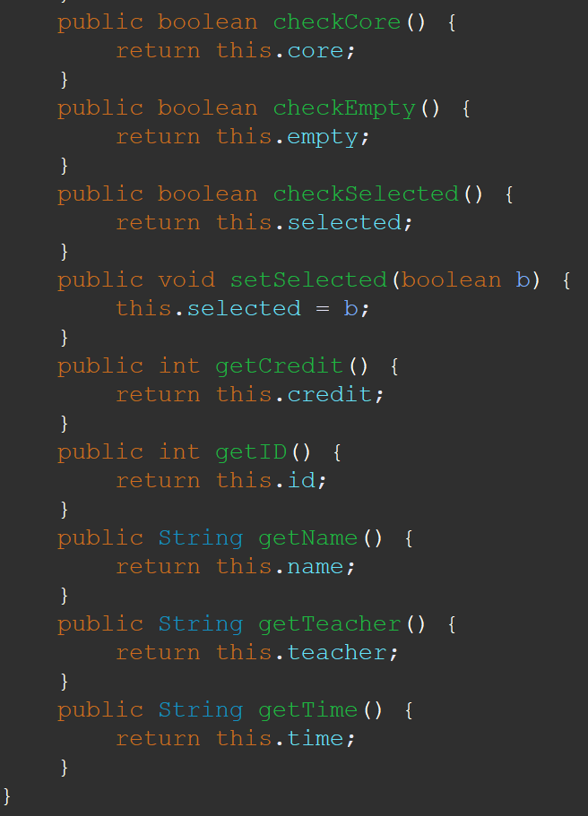
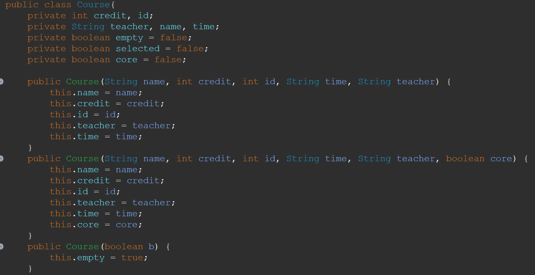
Class Course

Slide 9
Class
NCCUStudent
NCCUStudent
Modifier and type | Method (or Variable) and description
Instance variable
int | stdID The student ID.
int | grade The student’s grade.
int | department The student’s department.
int | sportCredit The sportCredit.
int | coreSelected The coreCourse has been selected.
int | totalGeneralCredit The total of the GeneralCredit.
int[] | generalCredit The total of the generalCredit.

Slide 10
Class
NCCUStudent
ArrayList<Course> | generalSelected An ArrayList that holds all general courses has been selected.
ArrayList<Course> | sportSelected An ArrayList that holds all sport courses has been selected.
Boolean[] | coreCheck check if the course is coreCourse.
Constructor
NCCUStudent(int stdID, int grade, int department) Enable to construct a NCCUstudent object with given student id, grade, department. Initialize generalSelected, sportSelected, generalCredit, coreCheck. Set sportCredit as 0,set coreSelected as 0, set totalGeneralCredit as 0.

Slide 11
Class
NCCUStudent
Instance Methods
- | 2 getter for 2 attributes(getStdId(), getGrade())
void | addGeneralCourse(Course c) 1. Check whether the course has been selected. 2. If the course has not been selected, add it to the student's course selection list and mark it as selected. 3. Perform different actions based on the category of the course: - For basic general courses, if the credit has not reached 6 credits, add the credit and update the total general credits. - For core general courses, if the credit has not reached 7 credits and meets the conditions for core courses, add the credit and update the total general credits. - For other general courses, if the credit has not reached 3 credits, add the credit and update the total general credits. 4. If the course has already been selected, do not perform any operations.
void | addSportCourse(Course c) Add the selected sport course to the student's list of sport courses and set the sport credit to 1.

Slide 12
Class
NCCUStudent
void | selectedList(int misSelectedCredit, boolean[] misCheck, MISCourses misCourses) Print a summary of the selected courses for a student, including general courses, sports courses, and information about the credits taken in each category. Additionally, it displays information about the remaining required courses, including compulsory courses that haven't been selected, courses from miscellaneous categories, and the shortage of credits in specific general education categories. The output provides a comprehensive overview of the student's course selections and the status of their progress toward fulfilling various academic requirements.(See output below)
void | selectedList(int misGraduateSelectedCredit, boolean[] misGraduateCheck, GraduateMISCourses graduatemisCourses) Print a summary of the graduate student's selected courses, including the selected graduate courses, the total credit fee, and a list of unselected graduate courses. The output provides a comprehensive overview of the student's progress in graduate studies, including earned credits, total credit fees, and a list of graduate courses not yet selected.

Slide 13
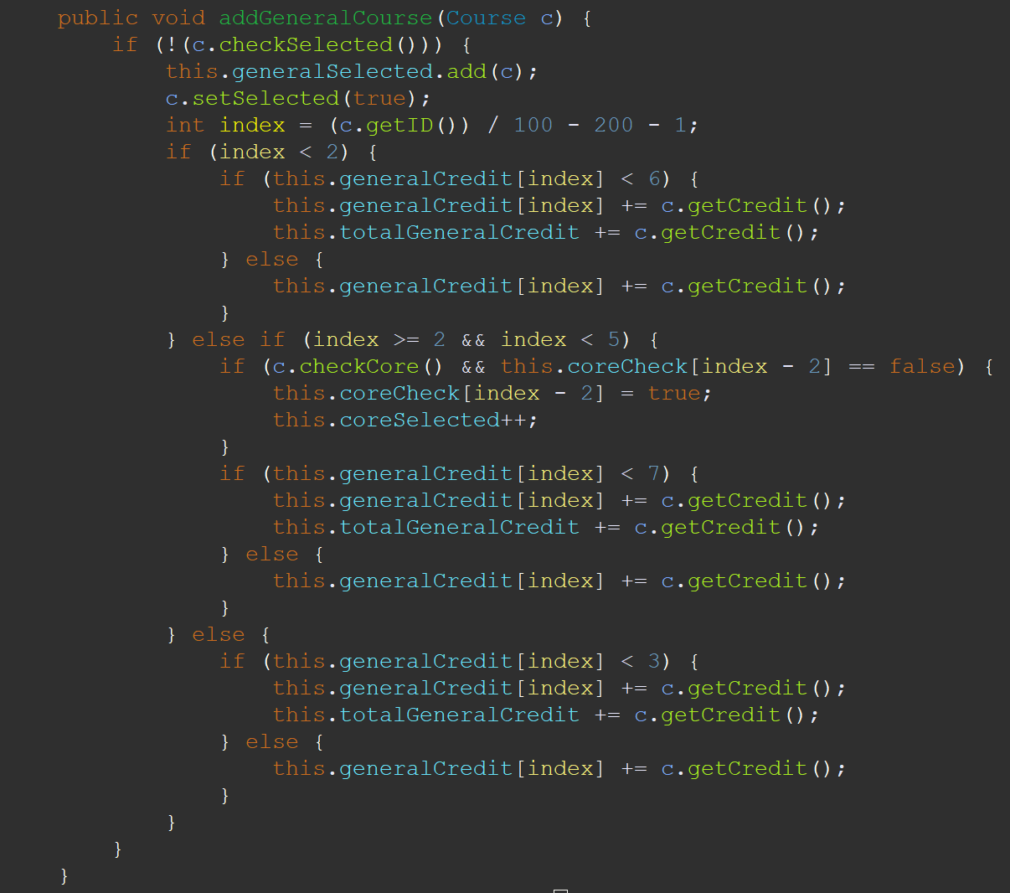
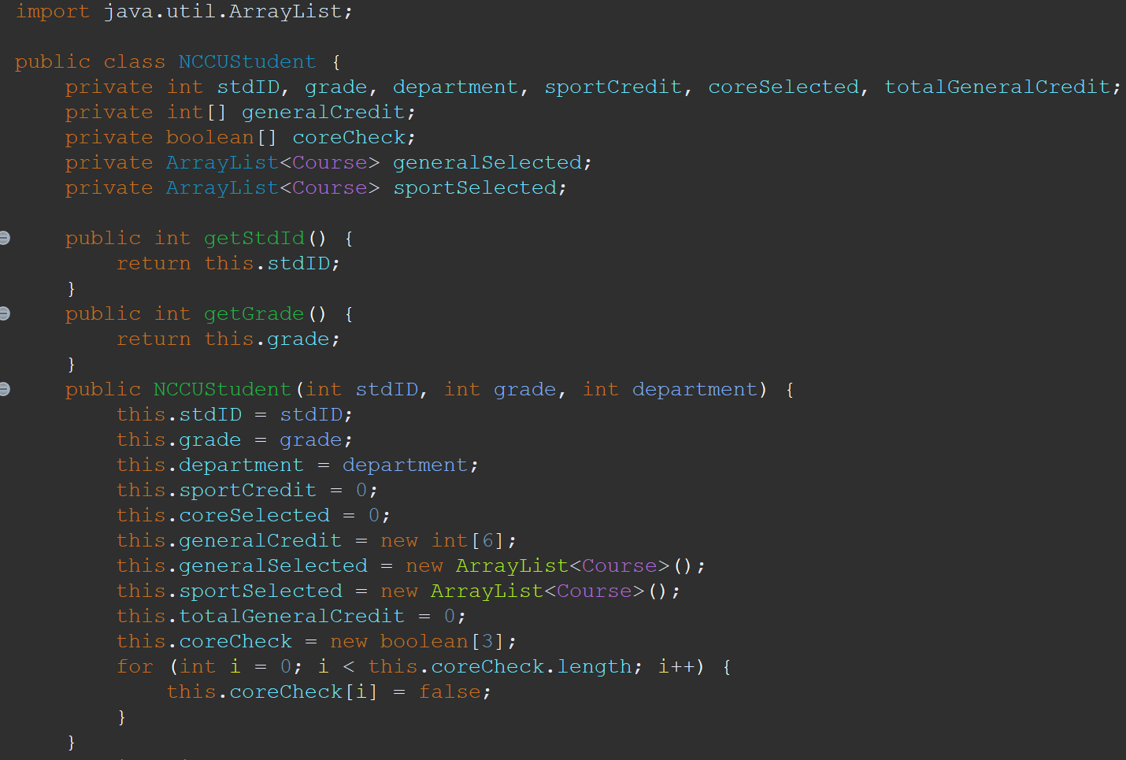
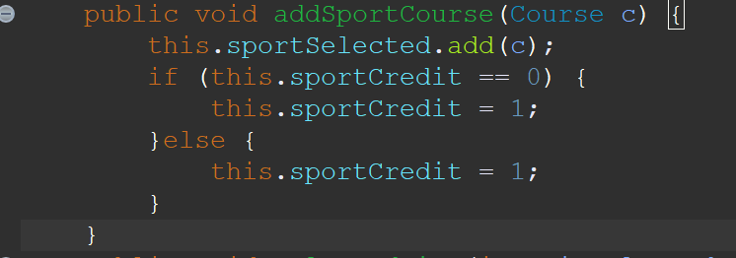
Class
NCCUStudent

Slide 14
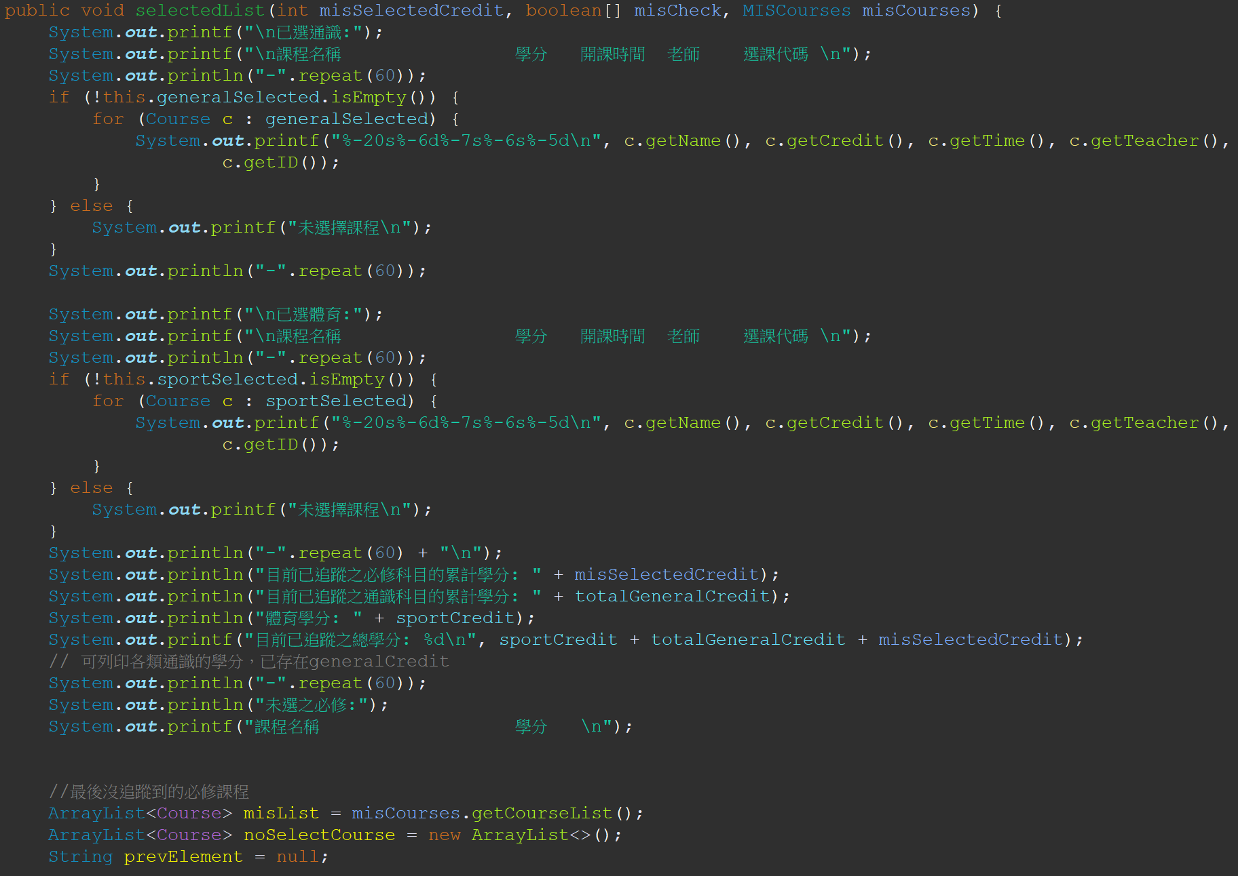
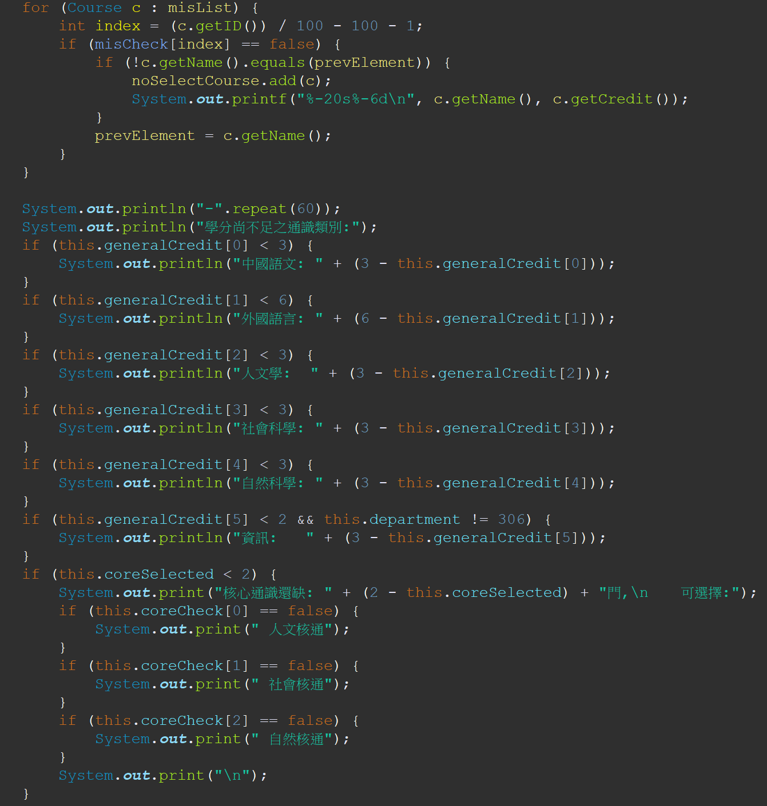
Class
NCCUStudent

Slide 15
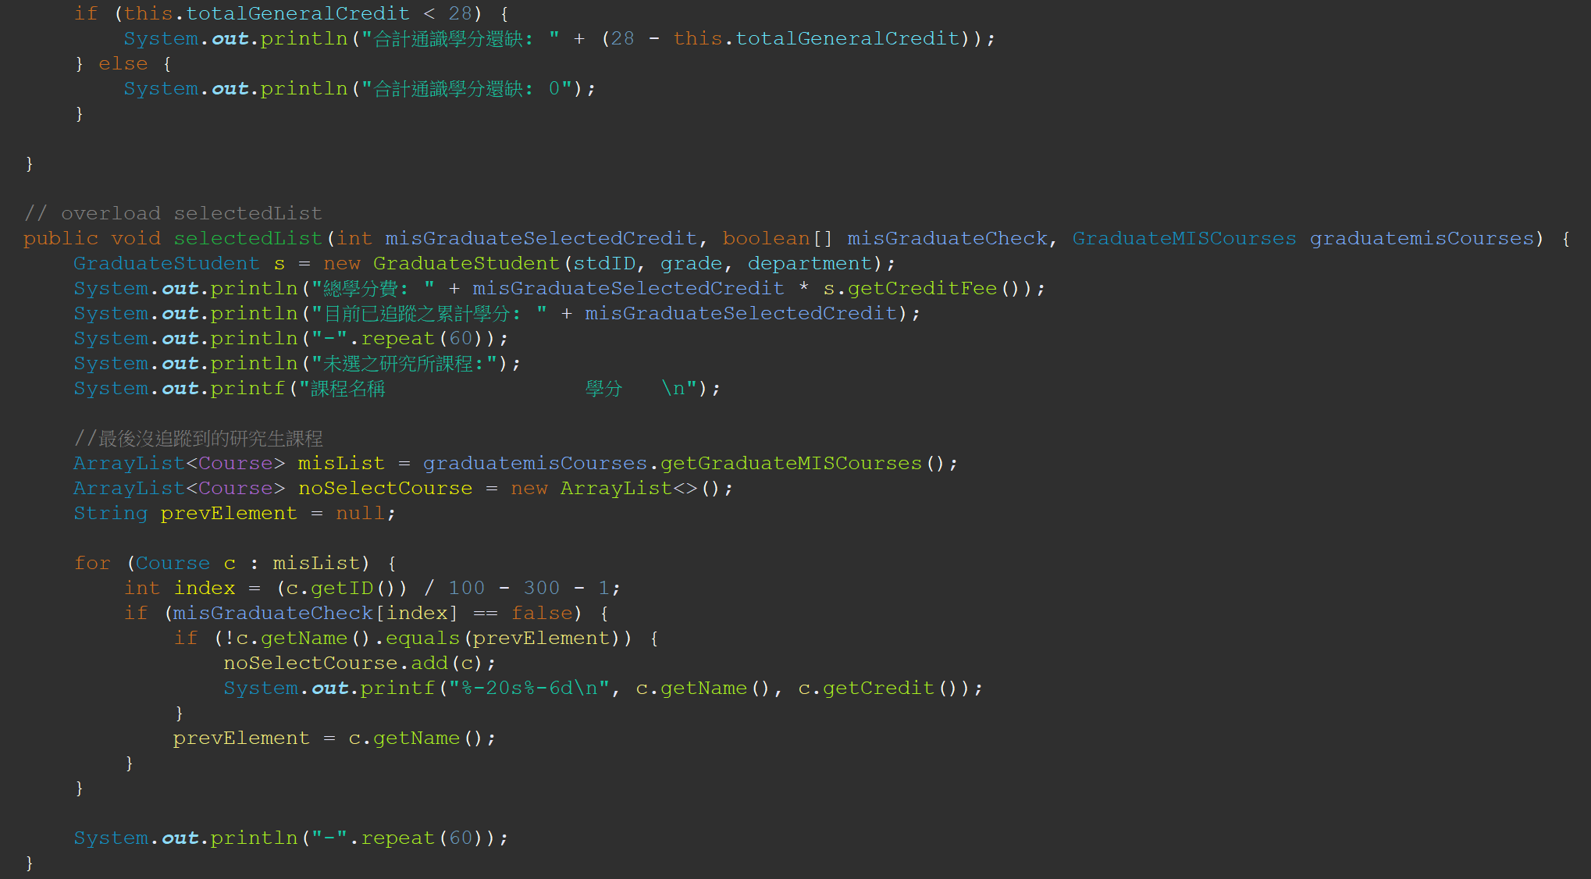
Class
NCCUStudent

Slide 16
Class
MISStudent
MISStudent
Modifier and type | Method (or Variable) and description
Instance variable
int | misSelectedCredit The credit has been selected.
boolean[] | misCheck Check if the student is MISSStudent.
ArrayList<Course> | misSelected An ArrayList that holds all courses has been selected.
String | departmentName The name of the department.

Slide 17
Class
MISStudent
Constructor
MISStudent(int stdID, int grade, int department) Enable to construct a MISStudent object with given stdID, grade, department from superclass (NCCUStudent).Initialize the misCheck, misSelected.Set departmentName as "資訊管理學系",misSelectedCredit as 0.
Instance Methods
void | addMisCourse(Course c) Add a MIS course to the list of selected courses for the student.
void | selectedList(MISCourses misCourses) Print a summary of selected MIS courses, including course name, credits, schedule, instructor, and course code. It also calls the selectedList method from the superclass (NCCU Student) to print additional information about general courses.
void | addMisCredit(Course c) Add the credits of a MIS course to the total credits of MIS courses for the student. It checks if the course has already been added to avoid duplicate credit calculations.

Slide 18
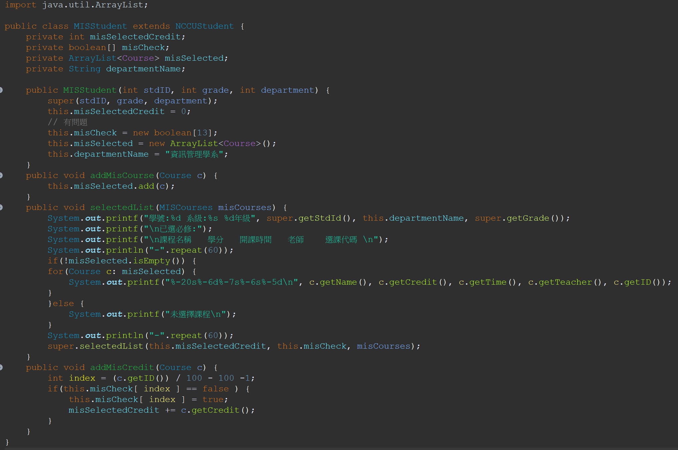
Class
MISStudent

Slide 19
Class
CourseFactory
CourseFactory
Modifier and type | Method (or Variable) and description
Instance variable
- | -
Constructor
-
Instance Methods
Course | createGeneralCourse(String name, int credit, int id, String time, String teacher) Create non-core general courses with given name, id, time, teacher.
Course | createGeneralCourse(String name, int credit, int id, String time, String teacher, boolean isCore) Create core general courses with given name, credit, id, time, teacher, isCore.
Course | createRequiredCourse(String name, int credit, int id, String time, String teacher) Generate required courses with given name, credit, id, time, teacher.
Course | createSportCourse(String name, int credit, int id, String time, String teacher) Generate Sport courses with given name, credit, id, time, teacher.
Course | createCourse(String name, int credit, int id, String time, String teacher) Generate graduate-level courses with given name, credit, id, time, teacher.

Slide 20
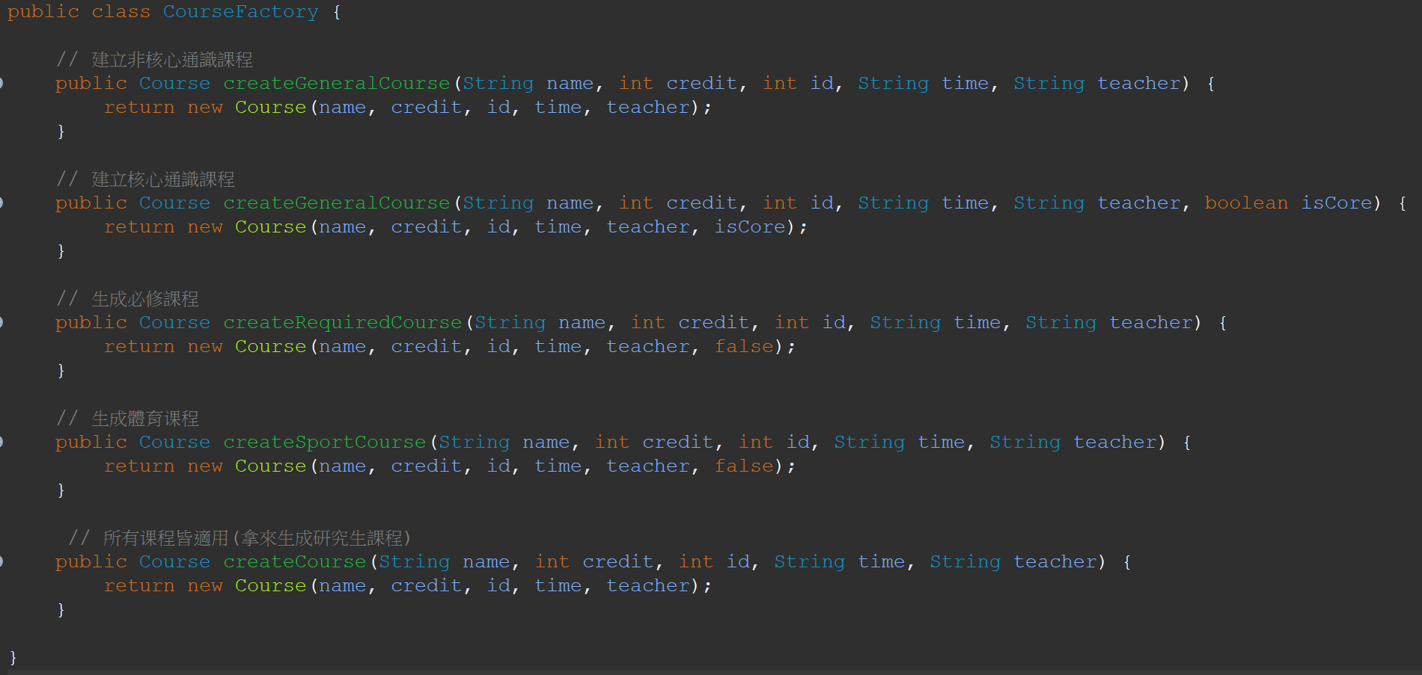
Class
CourseFactory
Design Pattern: Use multiple factory methods (createGeneralCourese, createRequiredCourse, createSportCourse, createCourse), which accept parameters that allow customization of the created Course object.
This enables flexibility in creating courses with different attributes.

Slide 21
Class
MISCourses
MISCourses
Modifier and type | Method (or Variable) and description
Instance variable
ArrayList<Course> | required An ArrayList that holds all required courses of MISStudent..
CourseFactory | courseFactory The CouseFactory object.
Constructor
MISCourses() Initialize the required, courseFactory. Use CourseFactory to create required courses.

Slide 22
Class
MISCourses
Instance Methods
void | addMisCourse(Course c) Add a course to the ArrayList(misSelected) .
void | selectedList(MISCourses misCourses) Generates and prints a formatted list of selected miscellaneous courses for a student. It displays information such as the student's ID, department, and grade, followed by the selected courses. The details of each selected course include its name, credit, time, teacher, and course ID. If no miscellaneous courses are selected, a message indicating the absence of selected courses is printed. Additionally, the method invokes the selectedList method from the superclass to display further details such as selected credits and specific courses tracked by the system.
void | addMisCredit(Course c) Updates the selected credits for a student based on a given course. It calculates the index of the course in the course array using the course ID. If the course has not been previously checked, the method sets misCheck[index] to true, indicating that the course has been processed. It then increments the misSelectedCredit by the credit value of the given course.

Slide 23
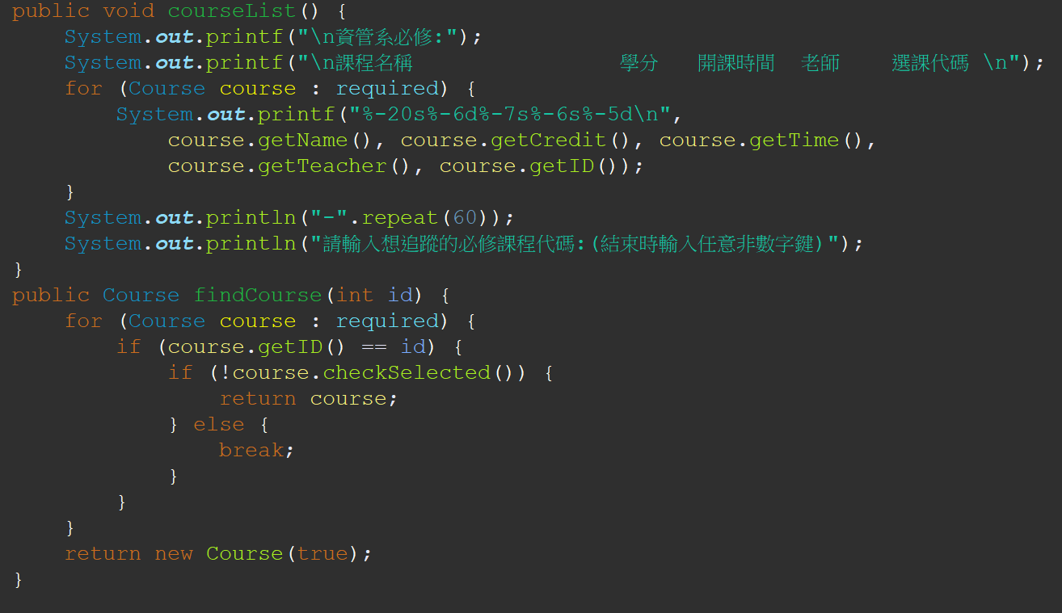
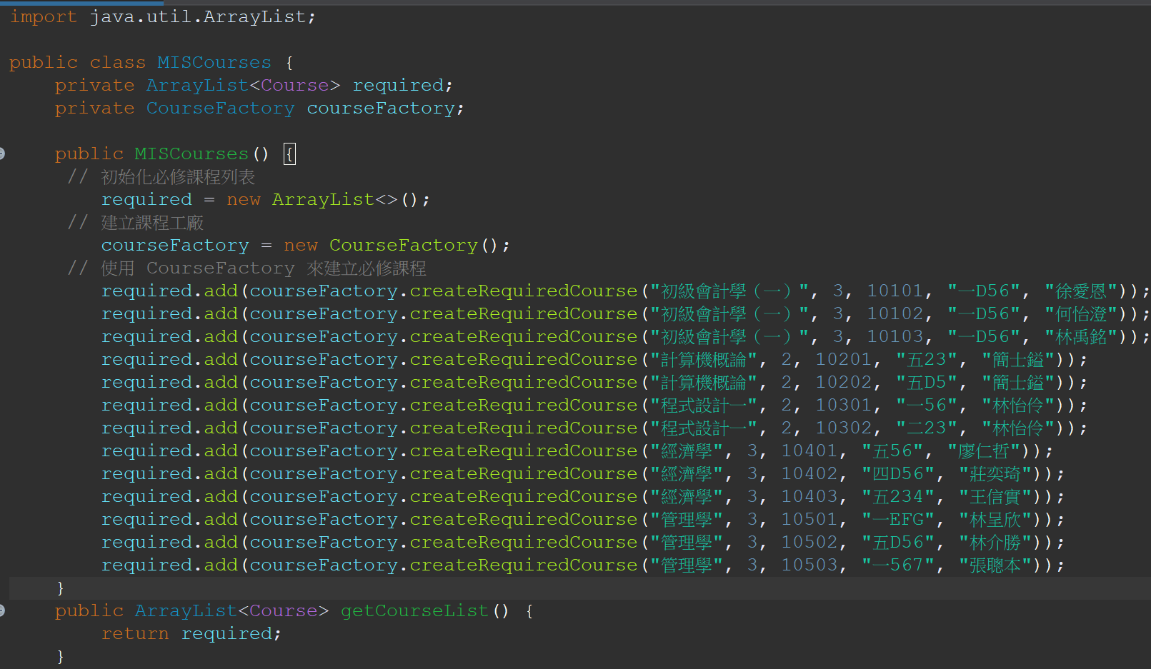
Class
MISCourses

Slide 24
Class
SelectMenu
SelectMenu
Modifier and type | Method (or Variable) and description
Instance variable
MISCourses | misCourses It allows access to methods and data related to these courses.
GeneralCourses | generalCourses It allows access to methods and data related to general courses.
SportCourses | sportCourses It allows access to methods and data related to sport courses.
GraduateMISCourses | graduatemisCourses It allows access to methods and data related to graduate-level information system courses.
Constructor
-

Slide 25
Class
SelectMenu
Instance Methods
void | selectMenu(MISStudent misStd, Scanner sc) this method aim to handle the course selection process for MIS students.It prompts the users to input the desired course category, displays the corresponding course list, and allows the users to add selected courses to the MIS student’s course list. The recursive calls facilitate continuous course selection until the users choose to exit.
void | selectMenu(GraduateStudent graduatemisStudent, Scanner sc) this method aim to manage the course selection process for graduate-level student.It prompts the users to input the desired course category, displays the corresponding course list, and allows the users to add selected courses to the graduate-level student’s course list. The recursive calls facilitate continuous course selection until the users choose to exit.
void | selectMenu(OtherStudent otherStd) this method aim to handle course selection for students other than MIS and graduate-level students.It prompts the users to input the desire course category and display relevant course lists.

Slide 26
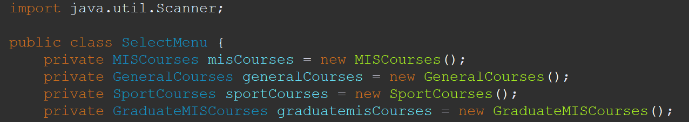
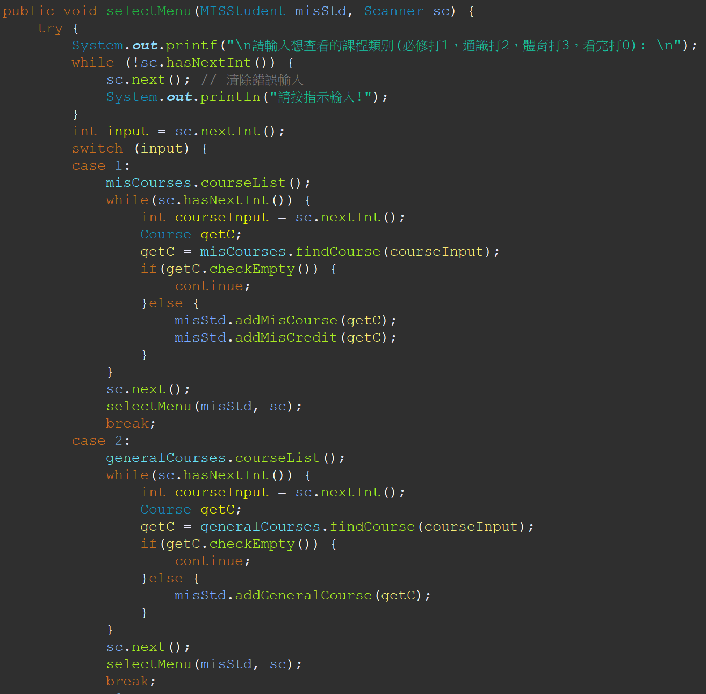
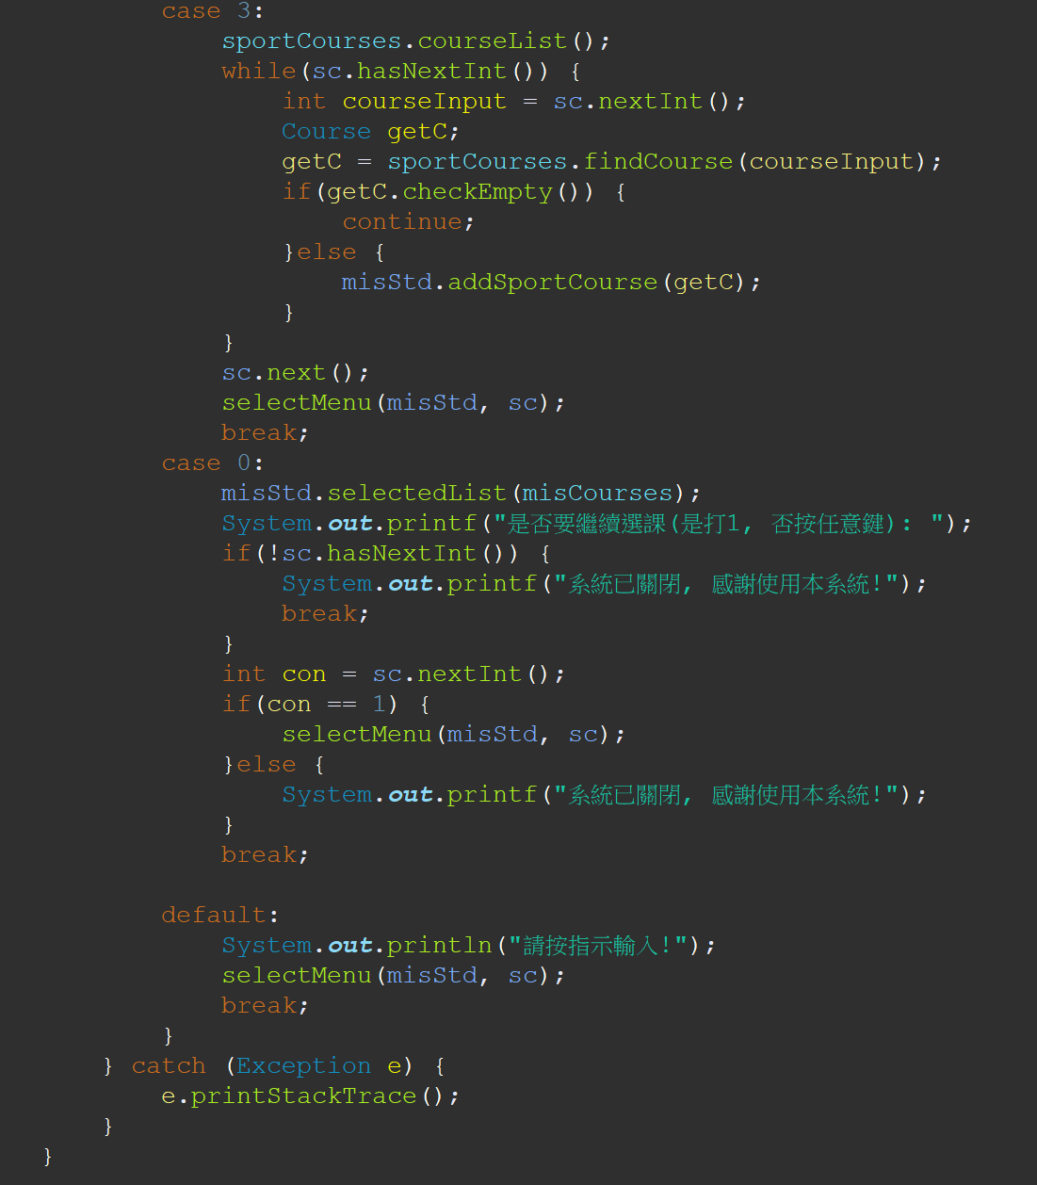
Class
SelectMenu

Slide 27
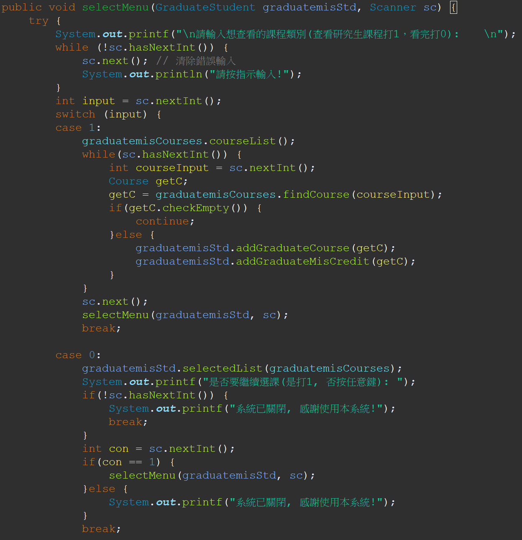
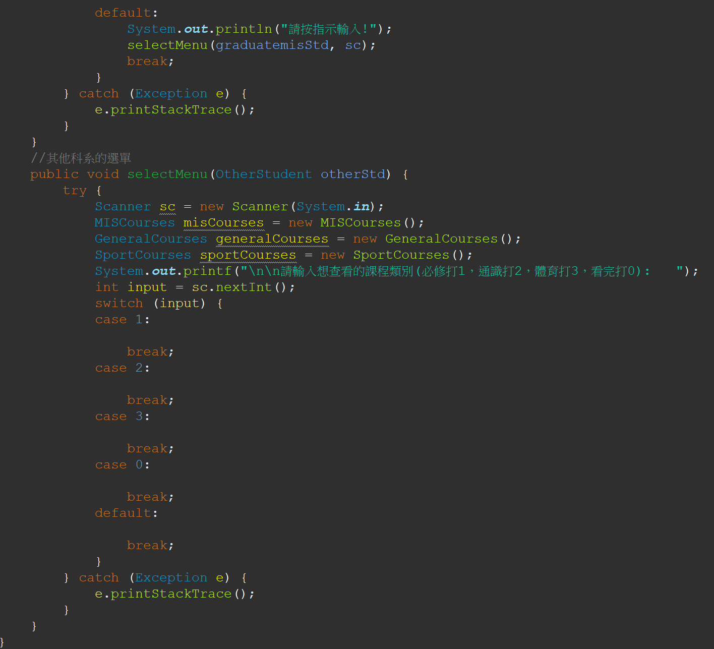
Class
SelectMenu

Slide 28
Class
SportCourses
SportCourses
Modifier and type | Method (or Variable) and description
Instance variable
ArrayList<Course> | sport The ArrayList holds instances of the Course class, representing sports-related course.
CourseFactory | courseFactory used for creating sports courses
Constructor
public SportCourses() Initializes the sport ArrayList and courseFactory. Use the courseFactory to create and add sports courses to the sport list.

Slide 29
Class
SportCourses
Instance Methods
void | courseList() Display a list of available sports courses. Prints a formatted list of sports courses, including courses’ details.It prompts the users to input the course ID of the sports course they want to select.
Course | findCourse(int id) Find and returns a sport course based on the provided course ID. Iterates through the sport list to find a course with a matching ID, if found and not selected, returns the course; otherwise, returns a new Course instance with a flag indicating it’s empty.

Slide 30
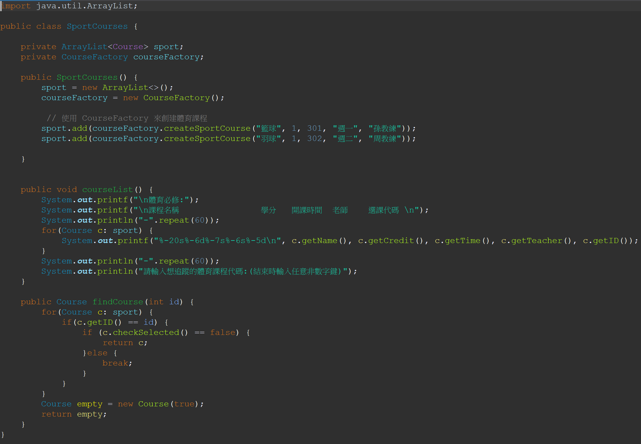
Class
SportCourses

Slide 31
Class
GeneralCourses
GeneralCourses
Modifier and type | Method (or Variable) and description
Instance variable
ArrayList<Course> | generalCH ArrayList to store categories of Chinese courses.
ArrayList<Course> | generalEN ArrayList to store categories of English courses.
ArrayList<Course> | generalHumanities ArrayList to store categories of humanities courses.
ArrayList<Course> | generalSocial ArrayList to store categories of social courses.
ArrayList<Course> | generalScience ArrayList to store categories of science courses.
ArrayList<Course> | generalComputer ArrayList to store categories of computer courses.

Slide 32
Class
GeneralCourses
Constructor
GeneralCourses() Initializes ArrayLists for different categories of general courses. Adding non-core and core general courses in the ArrayList separately.
Instance Methods
void | courseList() Prints a formatted list of general courses for each category, including details such as name, credit, time, teacher, and ID. Prompts the user to input the course code for the general course they want to track.
Course | findCourse(int id) Searches for a general course in each category based on the provided course ID. Returns the found course if it exists and has not been selected, if the course has already been selected or the ID is not found, it returns a special Course object.

Slide 33
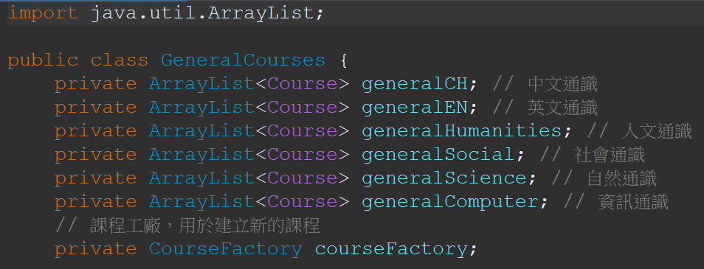
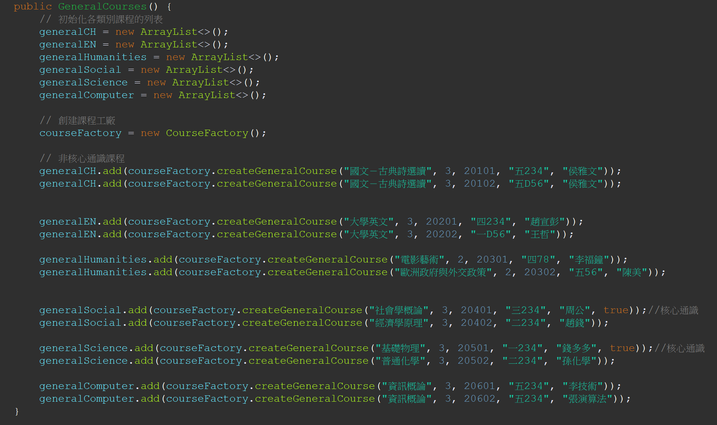
Class
GeneralCourses

Slide 34
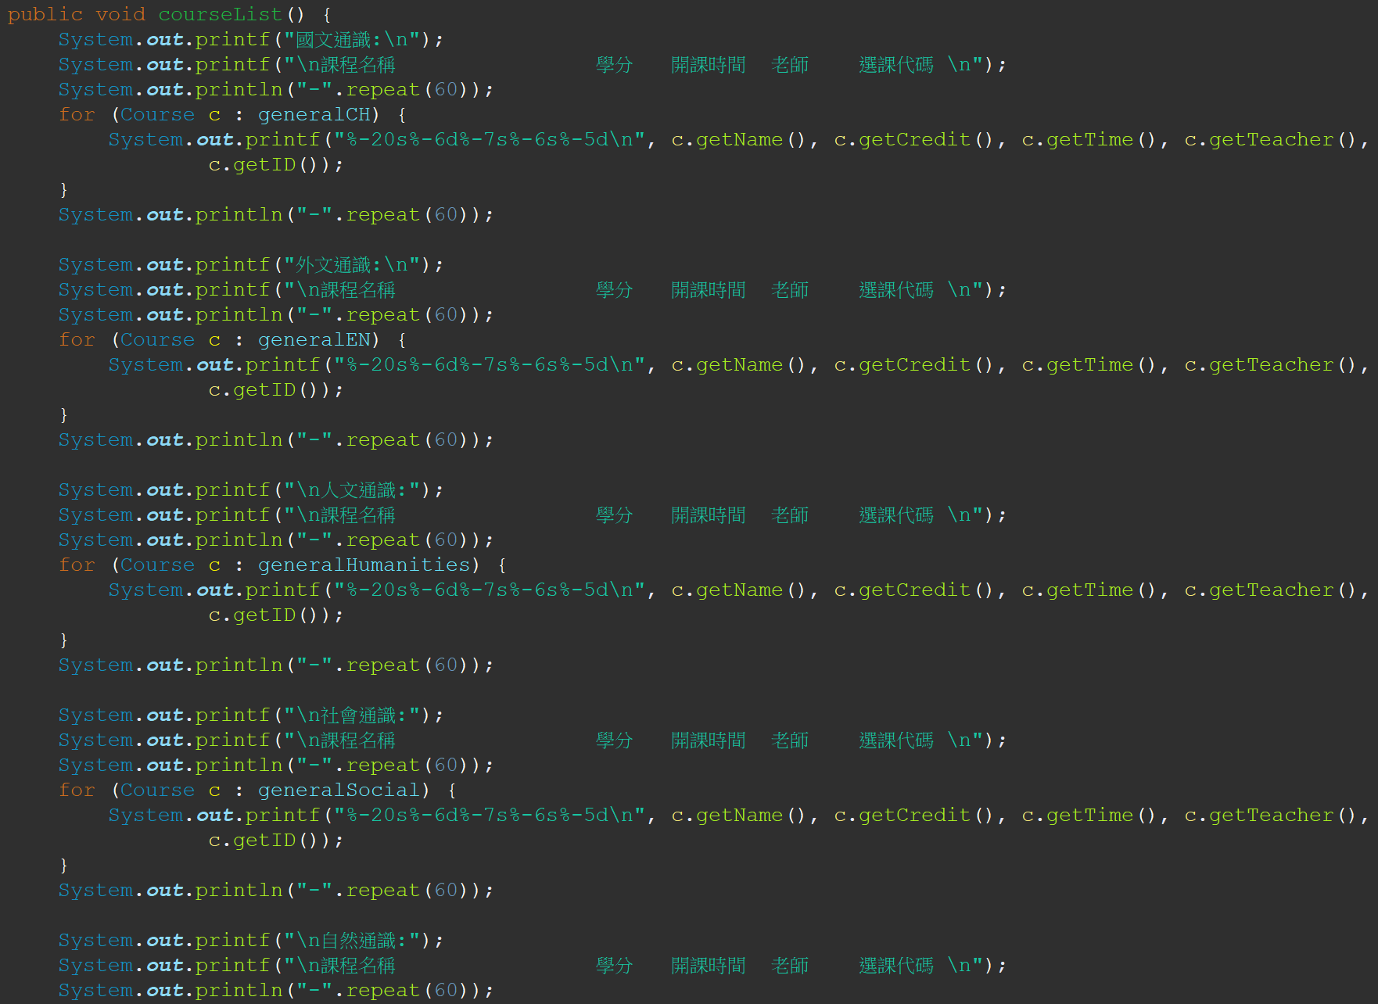
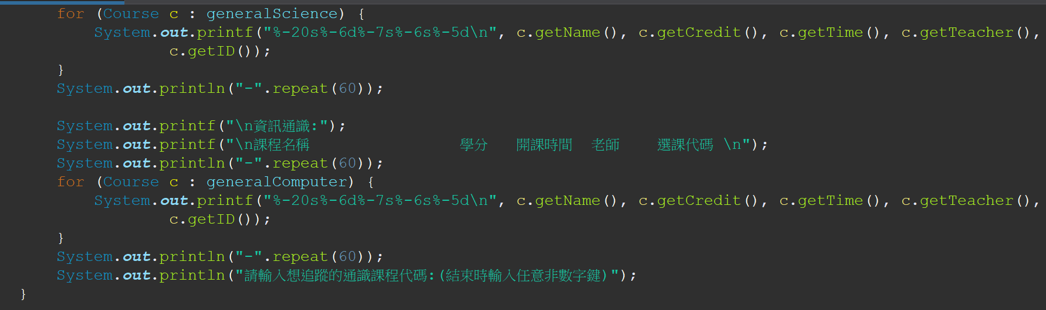
Class
GeneralCourses

Slide 35
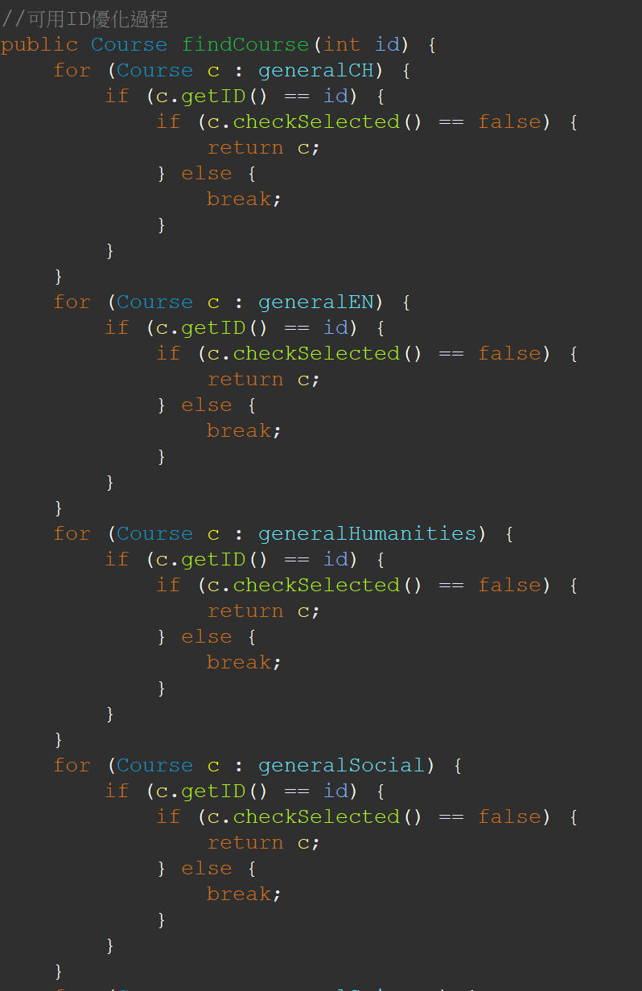
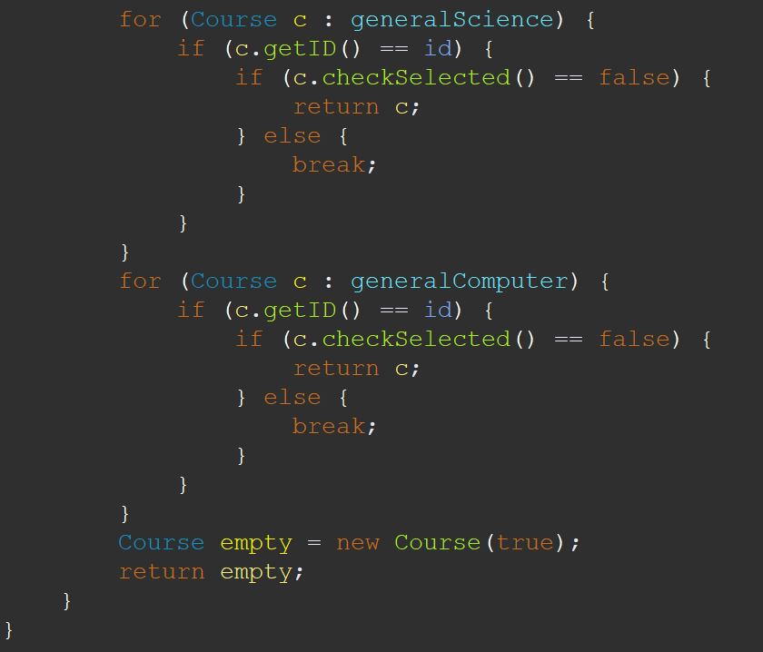
Class
GeneralCourses

Slide 36
Class GraduateMISCourses
GraduateMISCourses
Modifier and type | Method (or Variable) and description
Instance variable
ArrayList<Course> | graduateMISCourses An ArrayList that stores instances of graduate MIS courses.
CourseFactory | courseFactory Used for creating instances of courses.
Constructor
GraduateMISCourses() Initializes the graduateMISCourses ArrayList with instances of graduate MIS courses.

Slide 37
Class GraduateMISCourses
Instance Methods
- | 1 getter for 1 attributes(getGraduateMISCourses())
void | courseList() Prints a formatted list of graduate MIS courses, including details such as name, credit, time, teacher, and ID. Prompts the user to input the course code for the graduate MIS course they want to track.
Course | findCourse(int id) Searches for a graduate MIS course in the graduateMISCourses ArrayList based on the provided course ID. Returns the found course if it exists and has not been selected, if the course has already been selected or the ID is not found, it returns a special Course object.

Slide 38
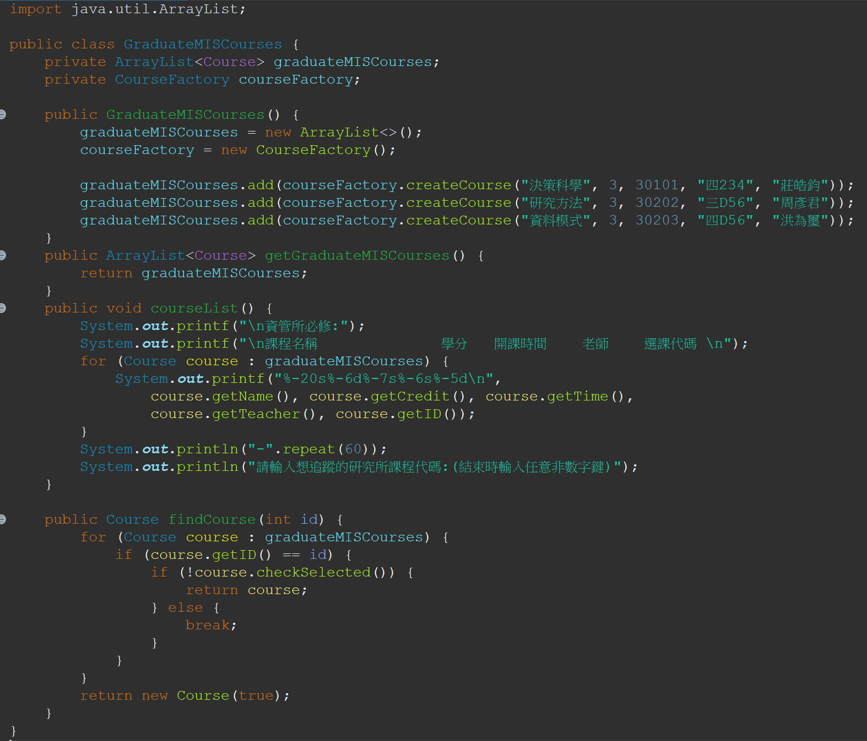
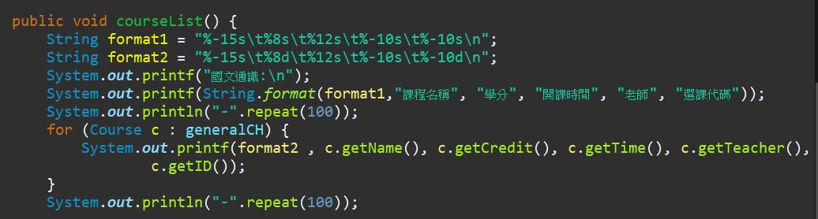
Class GraduateMISCourses

Slide 39
Class GraduateStudent
GraduateStudent
Modifier and type | Method (or Variable) and description
Instance variable
int | CreditFee Represents the cost per credit for graduate students.
int | totalCreditFee The total credit fee for graduate students.
int | misGraduateSelectedCredit Tracks the total number of credits selected by the student.
boolean[] | misGraduateCheck To check whether a specific course category has been selected.
ArrayList<Course> | misGraduateSelected To store the graduate courses selected by the student.
String | departmentName Represents the department name, set to "資訊管理學系."

Slide 40
Class GraduateStudent
Constructor
GraduateStudent(int stdID, int grade, int department) Calls the constructor of the superclass NCCUStudent to initialize basic student information. Initializes specific attributes related to graduate students.
Instance Methods
- | 2 getter for 2 attributes(getCreditFee(),getTotalCreditFee())
void | calculateCreditFee() Calculates the total credit fee based on the selected graduate MIS credits and the cost per credit.
void | addGraduateCourse(Course c) Adds a graduate MIS course to the list of selected courses.
void | selectedList(GraduateMISCourses graduatemisCourses) Prints a list of selected graduate MIS courses, including details such as name, credit, time, teacher, and ID. Calls the selectedList method from the superclass NCCUStudent to display additional information.

Slide 41
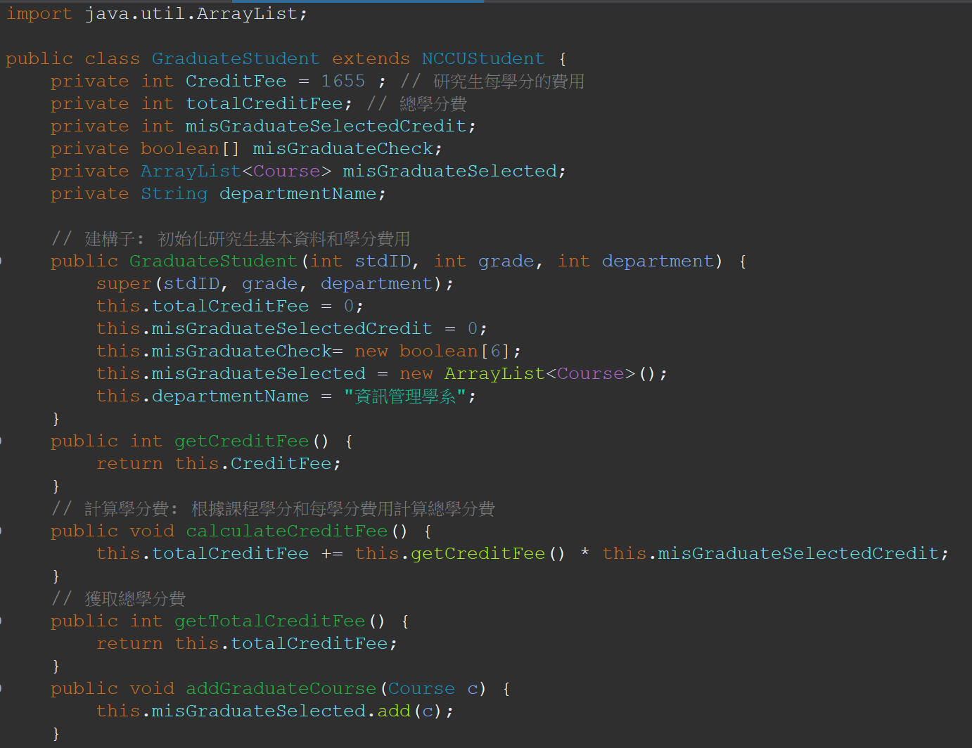
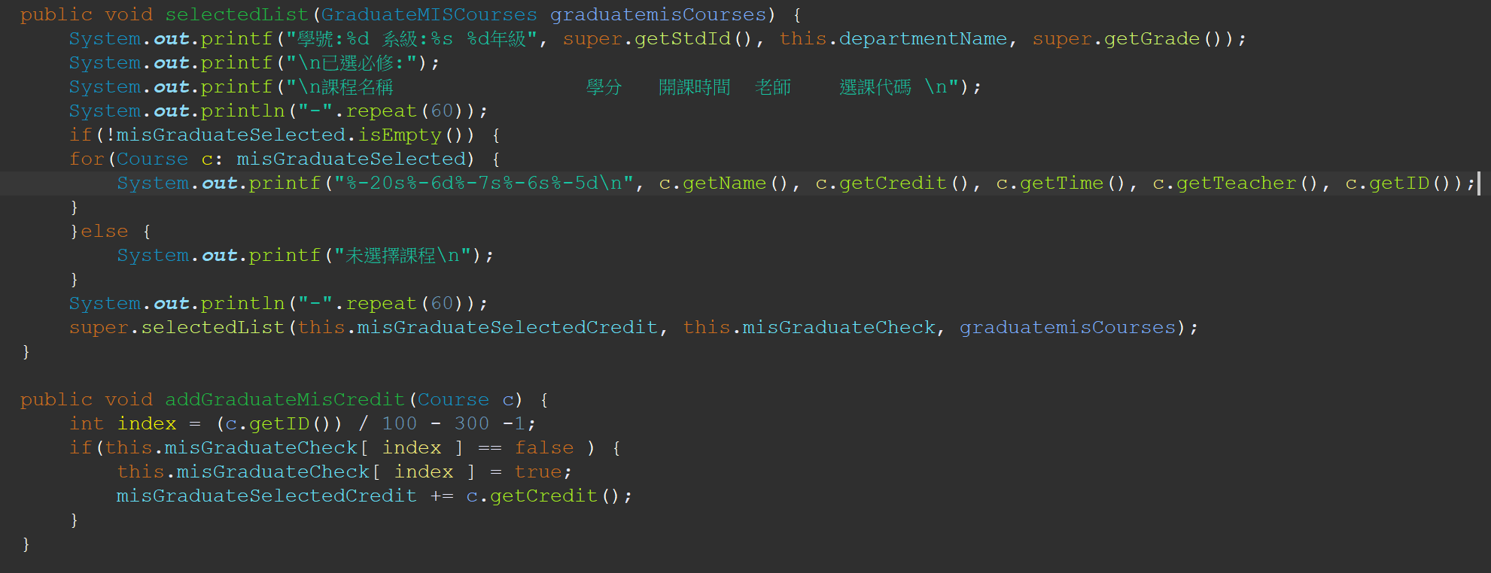
Class GraduateStudent

Slide 42
Main Class
Create main class
a.User Input and Student Initialization:
1.Prompts the user to input a student's ID, grade, and department code.
2.The user is informed about the department codes for different departments
(e.g., 306 for MIS, 356 for MIS graduate, 0 for other departments).
3.Based on the user's input, an instance of either MISStudent, GraduateStudent, or OtherStudent is created.
b.Menu Selection:
1.Creates an instance of the SelectMenu class.
2.The selectMenu method of the SelectMenu class is then called with the appropriate student object and a Scanner object to manage the menu selection.
c.Loop and Error Handling:
1.Use a loop to ensure correct user input for student information.
2.If the user enters an invalid input (e.g., a non-integer), an error message is displayed, and the user is prompted to input the correct information.

Slide 43
Main Class
Create main class
d.Department Code Validation:
1.Check the department code entered by the user and create an instance of the appropriate
student type.
2.If the department code is not recognized, the user is prompted to enter the correct department code.
e.Exception Handling:
1.Use try-catch block to catch any exceptions that might occur during user input or object creation.

Slide 44
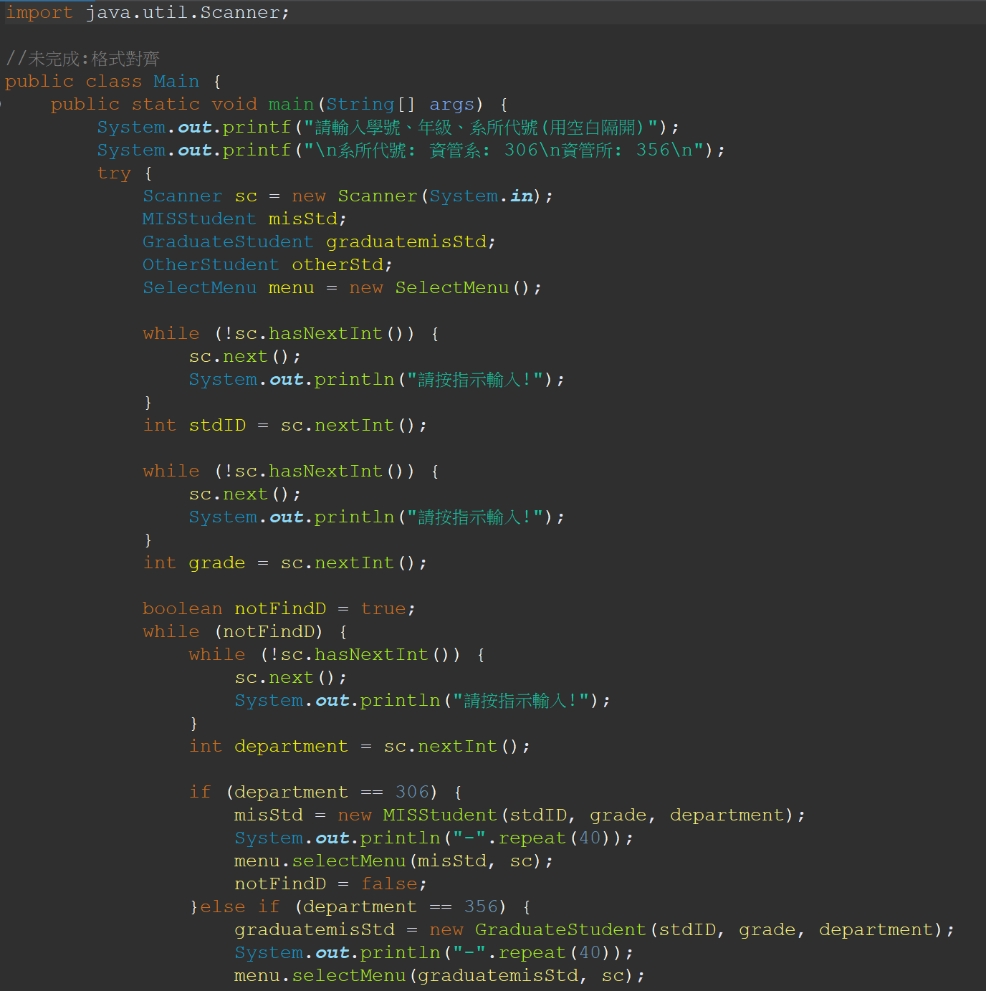
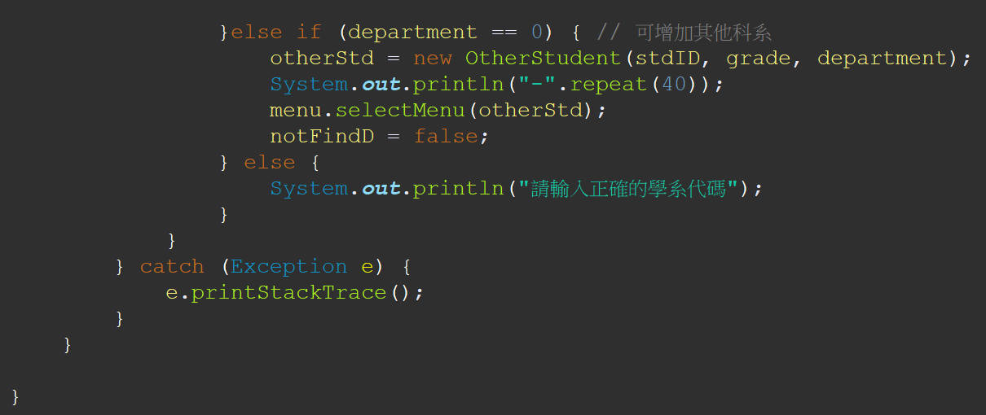

Main Class

Slide 45
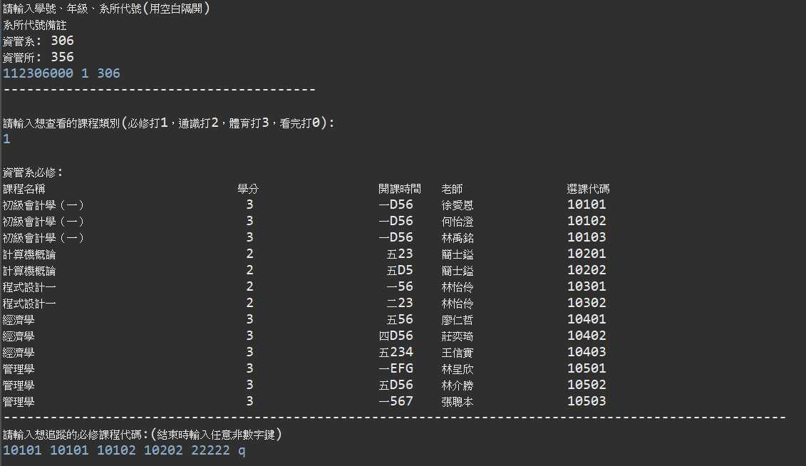
Sample Output - 學士生選課操作(必修)

Slide 46
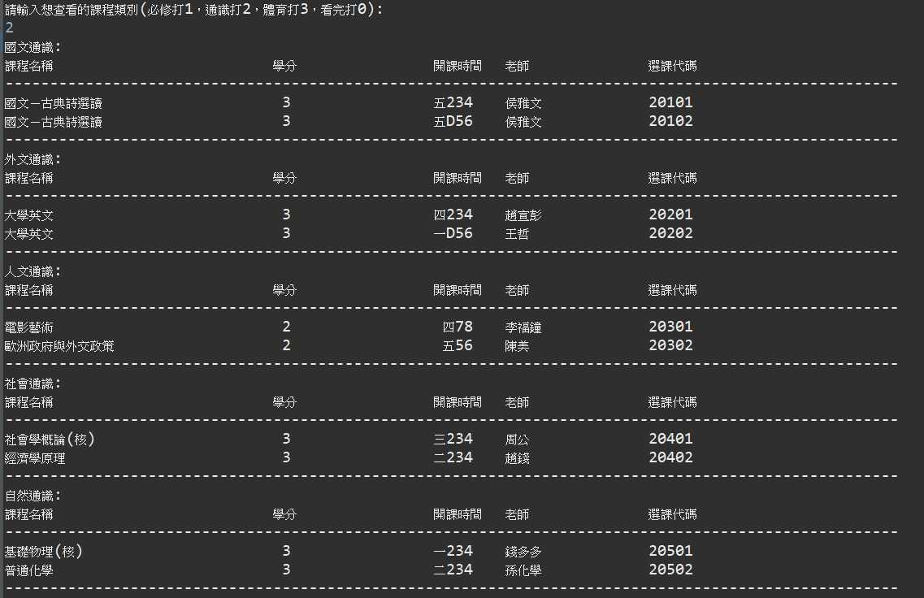
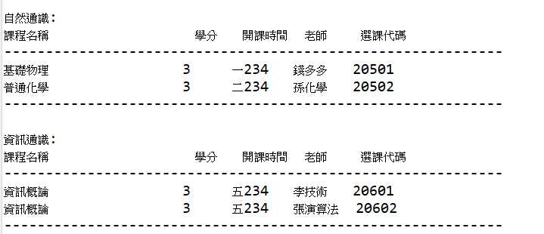
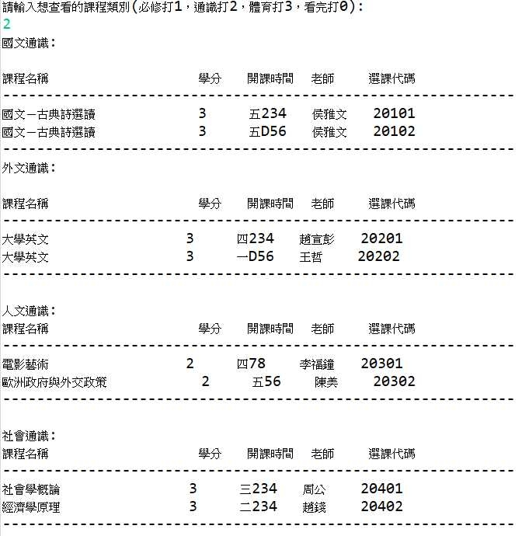
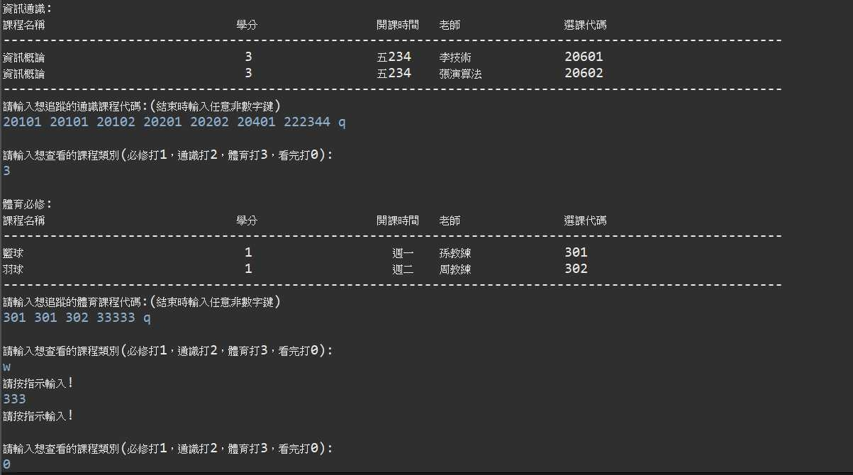
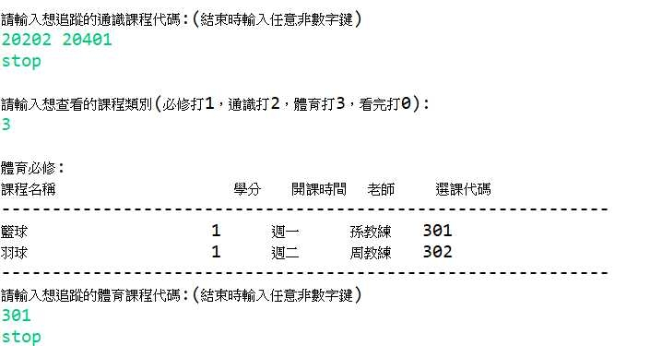
Sample Output - 學士生選課操作(通識、體育)

Slide 47
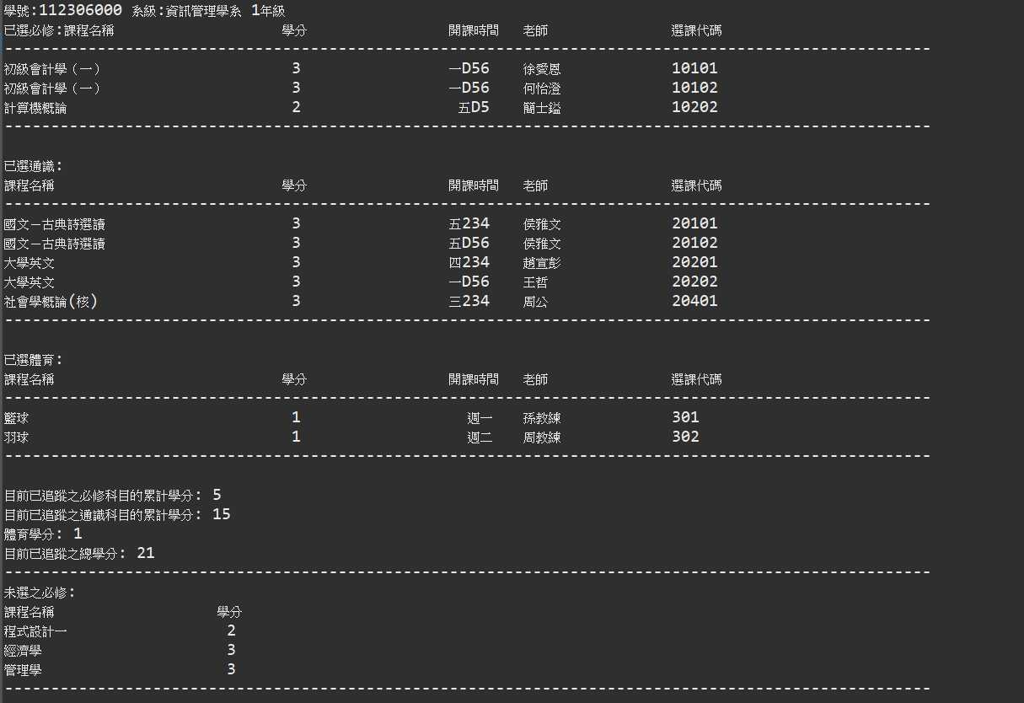
Sample Output
學士生選課結果

Slide 48
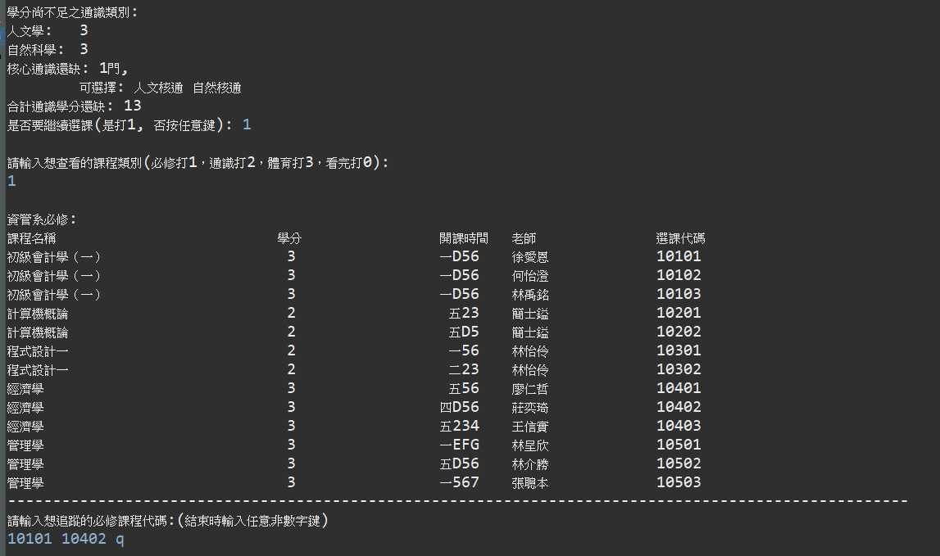
Sample Output
學士班選課結果

Slide 49
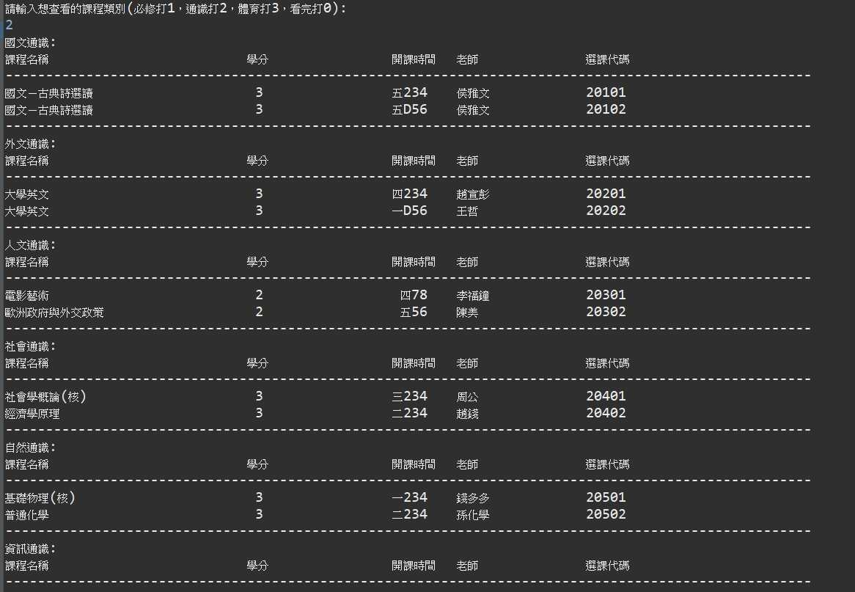
Sample Output
學士班選課結果

Slide 50
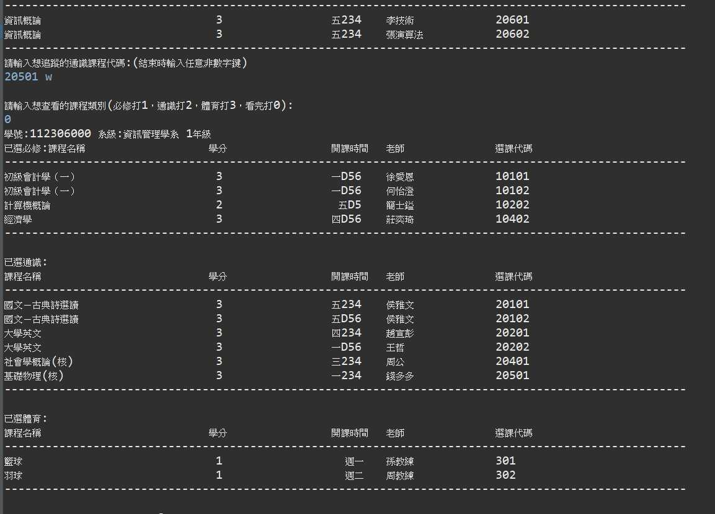
Sample Output
學士班選課結果

Slide 51
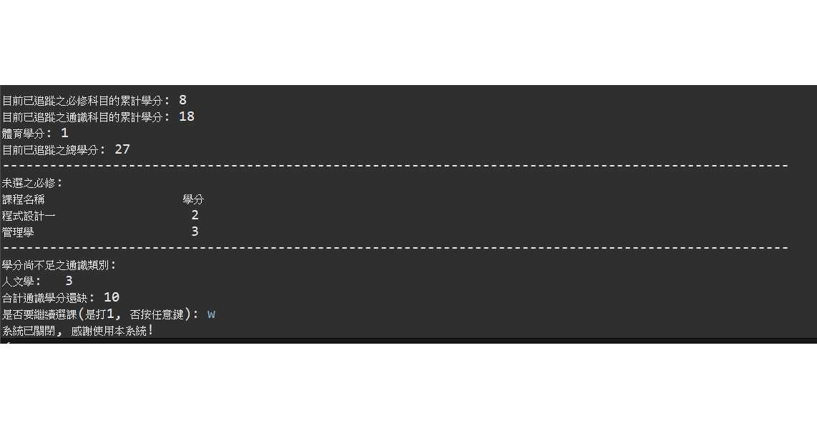
Sample Output
學士班選課系統

Slide 52
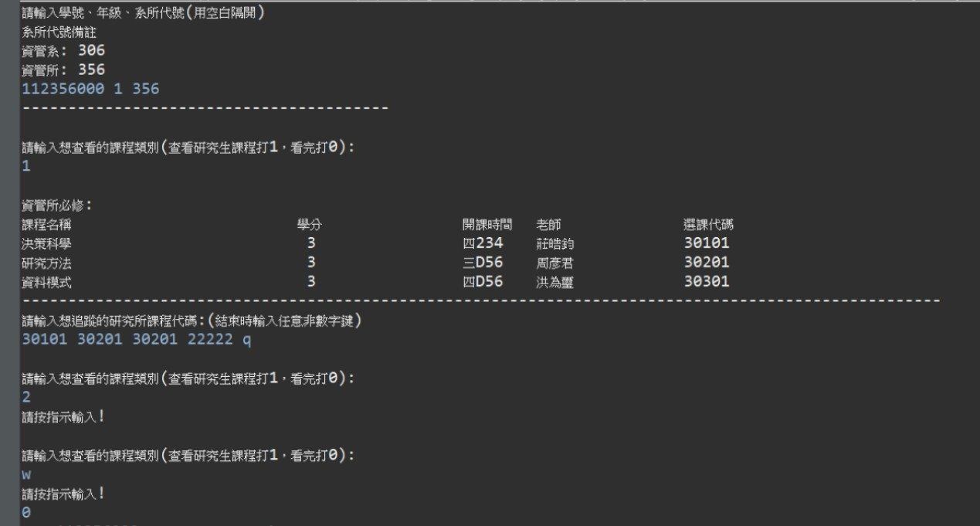
Sample Output - 研究生選課操作(必修)

Slide 53
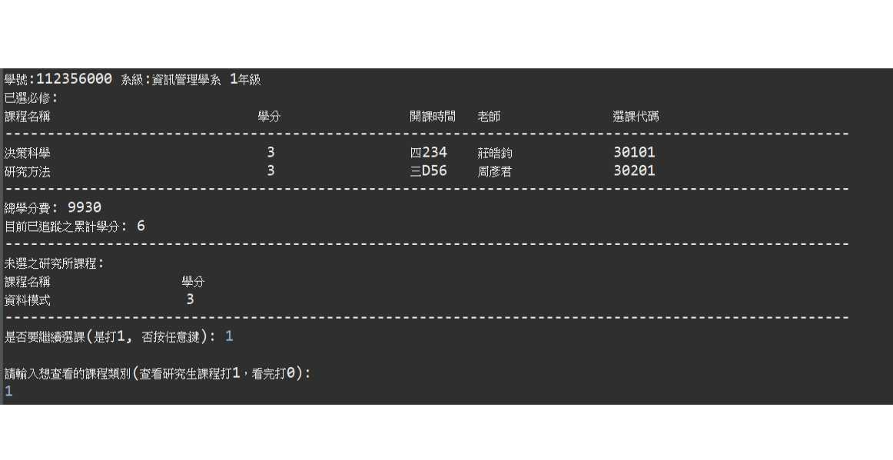
Sample Output-研究生選課結果(必修)

Slide 54
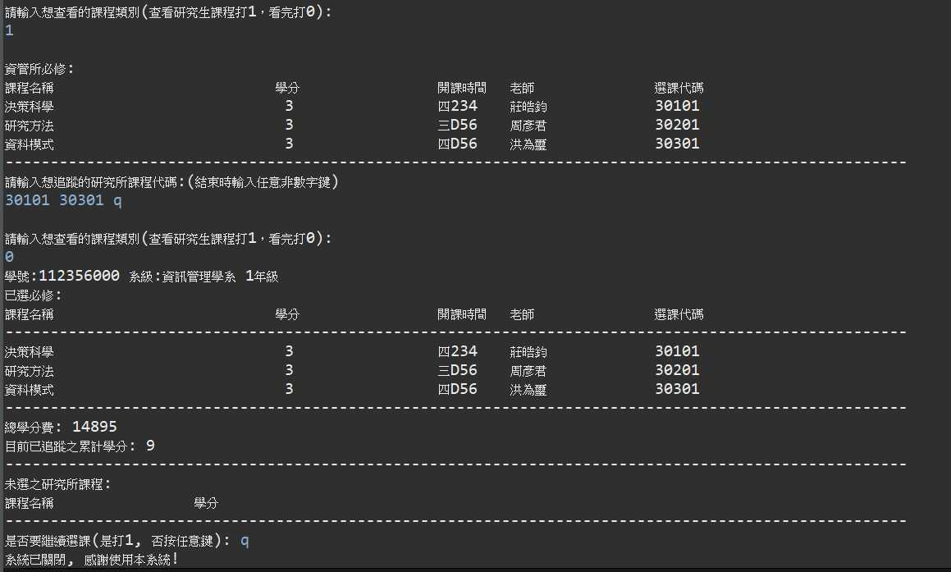
Sample Output-研究生選課結果(必修)

Slide 55
THANK YOU

